Slide 1







Fluorinated nanocarbons as promising additives for lubrication
P. Thomas¹, J.L. Mansot^{1,2}, A. Molza², K. Guérin^{3,} M. Dubois³
¹ Groupe de Technologie des Surfaces et Interfaces (GTSI), EA 2432, Université des Antilles, 97159 Pointe à Pitre Cedex, France
² Centre Commun de Caractérisation des Antilles et de la Guyane, Université des Antilles, 97159 Pointe à Pitre Cedex, France
³ Institut de Chimie de Clermont-Ferrand, UMR CNRS-6002, Université Blaise Pascal de Clermont-Ferrand, 63177 Aubière , France

Slide 2
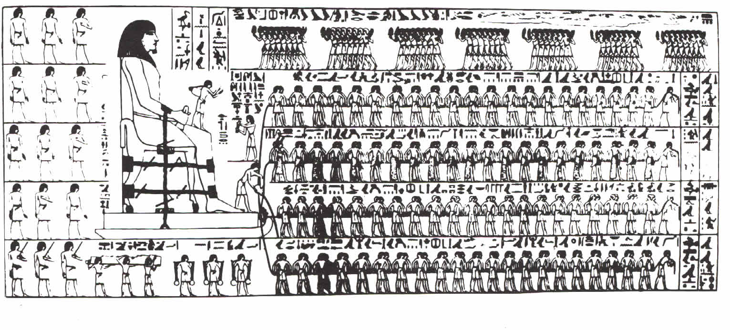
A few words about tribology
Tribology: part of science concerned with friction, wear and
lubrication processes involved in many natural and industrial
domains
Relative movement of two contacting surfaces: friction and wear
Energy losses
30% of produced energy in
the world is lost by friction
Materials losses
66 million euros/year in France
Lubrication: prevents contact between sliding surfaces
Notes:
Billion = milliards

Slide 3
Lubrication regimes
Liquid lubricant: base + additives
Antiwear additive
Friction reducer
Additives
Anti-oxidizing action
Corrosion inhibitor
Viscosity action
Base: mineral or synthetic oil

Slide 4
Lubrication regimes
Liquid lubricant: base + additives
Antiwear additive
Friction reducer
Additives
Anti-oxidizing action
Corrosion inhibitor
Viscosity action
Base: mineral or synthetic oil
Sliding speed of moving surfaces
4 lubrication regimes
Lubricant viscosity
Normal load

Slide 5

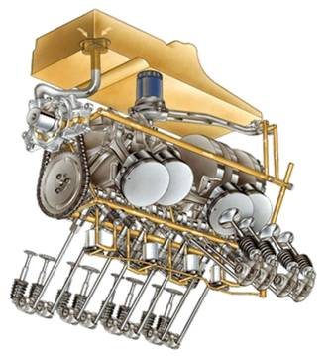
Lubrication regimes
Friction reduction due to
Base +
Additives
Additives
Base
Base
Fn
Ft
Elasto-HydroDynamic regime
HydroDynamic regime
Boundary regime
Film thickness (h)
Mixed regime
Friction coefficient (µ)
η : Lubricant viscosity
F_{N} : Normal load
V : Sliding speed
ηV/F_{N}

Slide 6
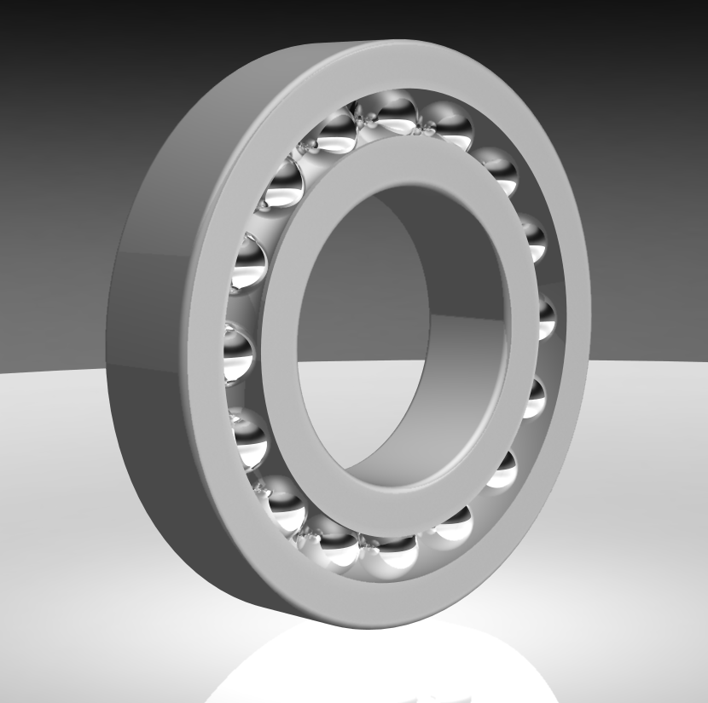
Lubrication regimes
Friction reduction due to
Base +
Additives
Additives
Base
Base
Fn
Ft
Elasto-HydroDynamic regime
HydroDynamic regime
Boundary regime
Film thickness (h)
Mixed regime
Friction coefficient (µ)
η : Lubricant viscosity
F_{N} : Normal load
V : Sliding speed
ηV/F_{N}
High friction coefficient
Severe wear
Ball bearings

Slide 7
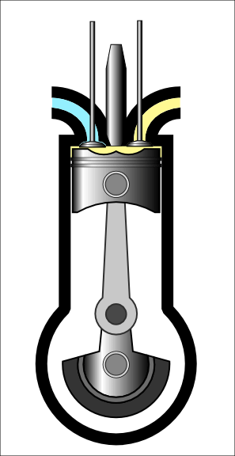
Lubrication regimes
Friction reduction due to
Base +
Additives
Additives
Base
Base
Fn
Ft
Elasto-HydroDynamic regime
HydroDynamic regime
Boundary regime
Film thickness (h)
Mixed regime
Friction coefficient (µ)
η : Lubricant viscosity
F_{N} : Normal load
V : Sliding speed
ηV/F_{N}
High friction coefficient
Severe wear
Performances due to antiwear and friction reduction additives
Engines

Slide 8
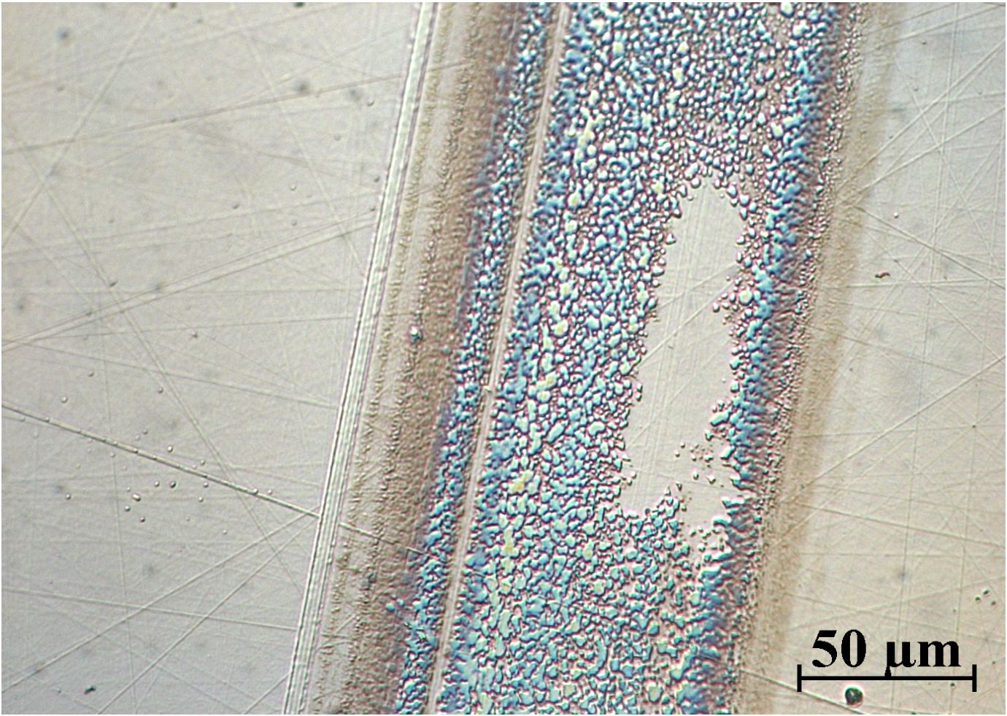
Conventional friction reduction
and antiwear additives
Conventional additives: Zinc DialkylDithiophosphate (ZDDP),
Molybdenum Dithiophosphate (MoDTP) or Dithiocarbamate (MoDTC)
Built up of a protective tribofilm resulting from chemical
reactions between additives molecules and surfaces
Tribofilm
Additives molecules
But
- The tribofilm is not immediately built (induction period) → severe wear undergone
by the substrates
The protective action is not efficient in the case of non-reactive sliding surfaces
(ceramics,…)

Slide 9
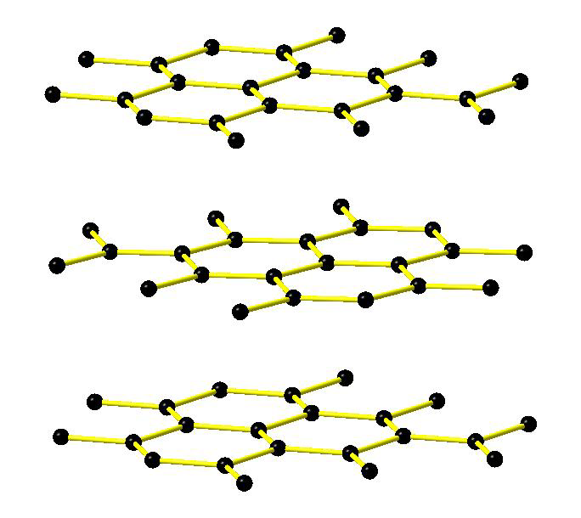
New lubrication strategies
New additives: micro/nanoparticles of tribo-active phases (graphite,
MoS₂) or precursors of tribo-active phases (C and inorganic
nanotubes or fullerenes) dispersed in the lubricant base
Phases are selected according to their intrinsic friction
properties
van der Waals
gap
Good lubricant
if μ ≤ 0,1
Graphite: μ = 0,1 CFx: μ = 0,09
Fluorinated carbons
Good friction properties
Anticorrosive and
hydrophobic properties
High chemical stability
Good thermal stability

Slide 10
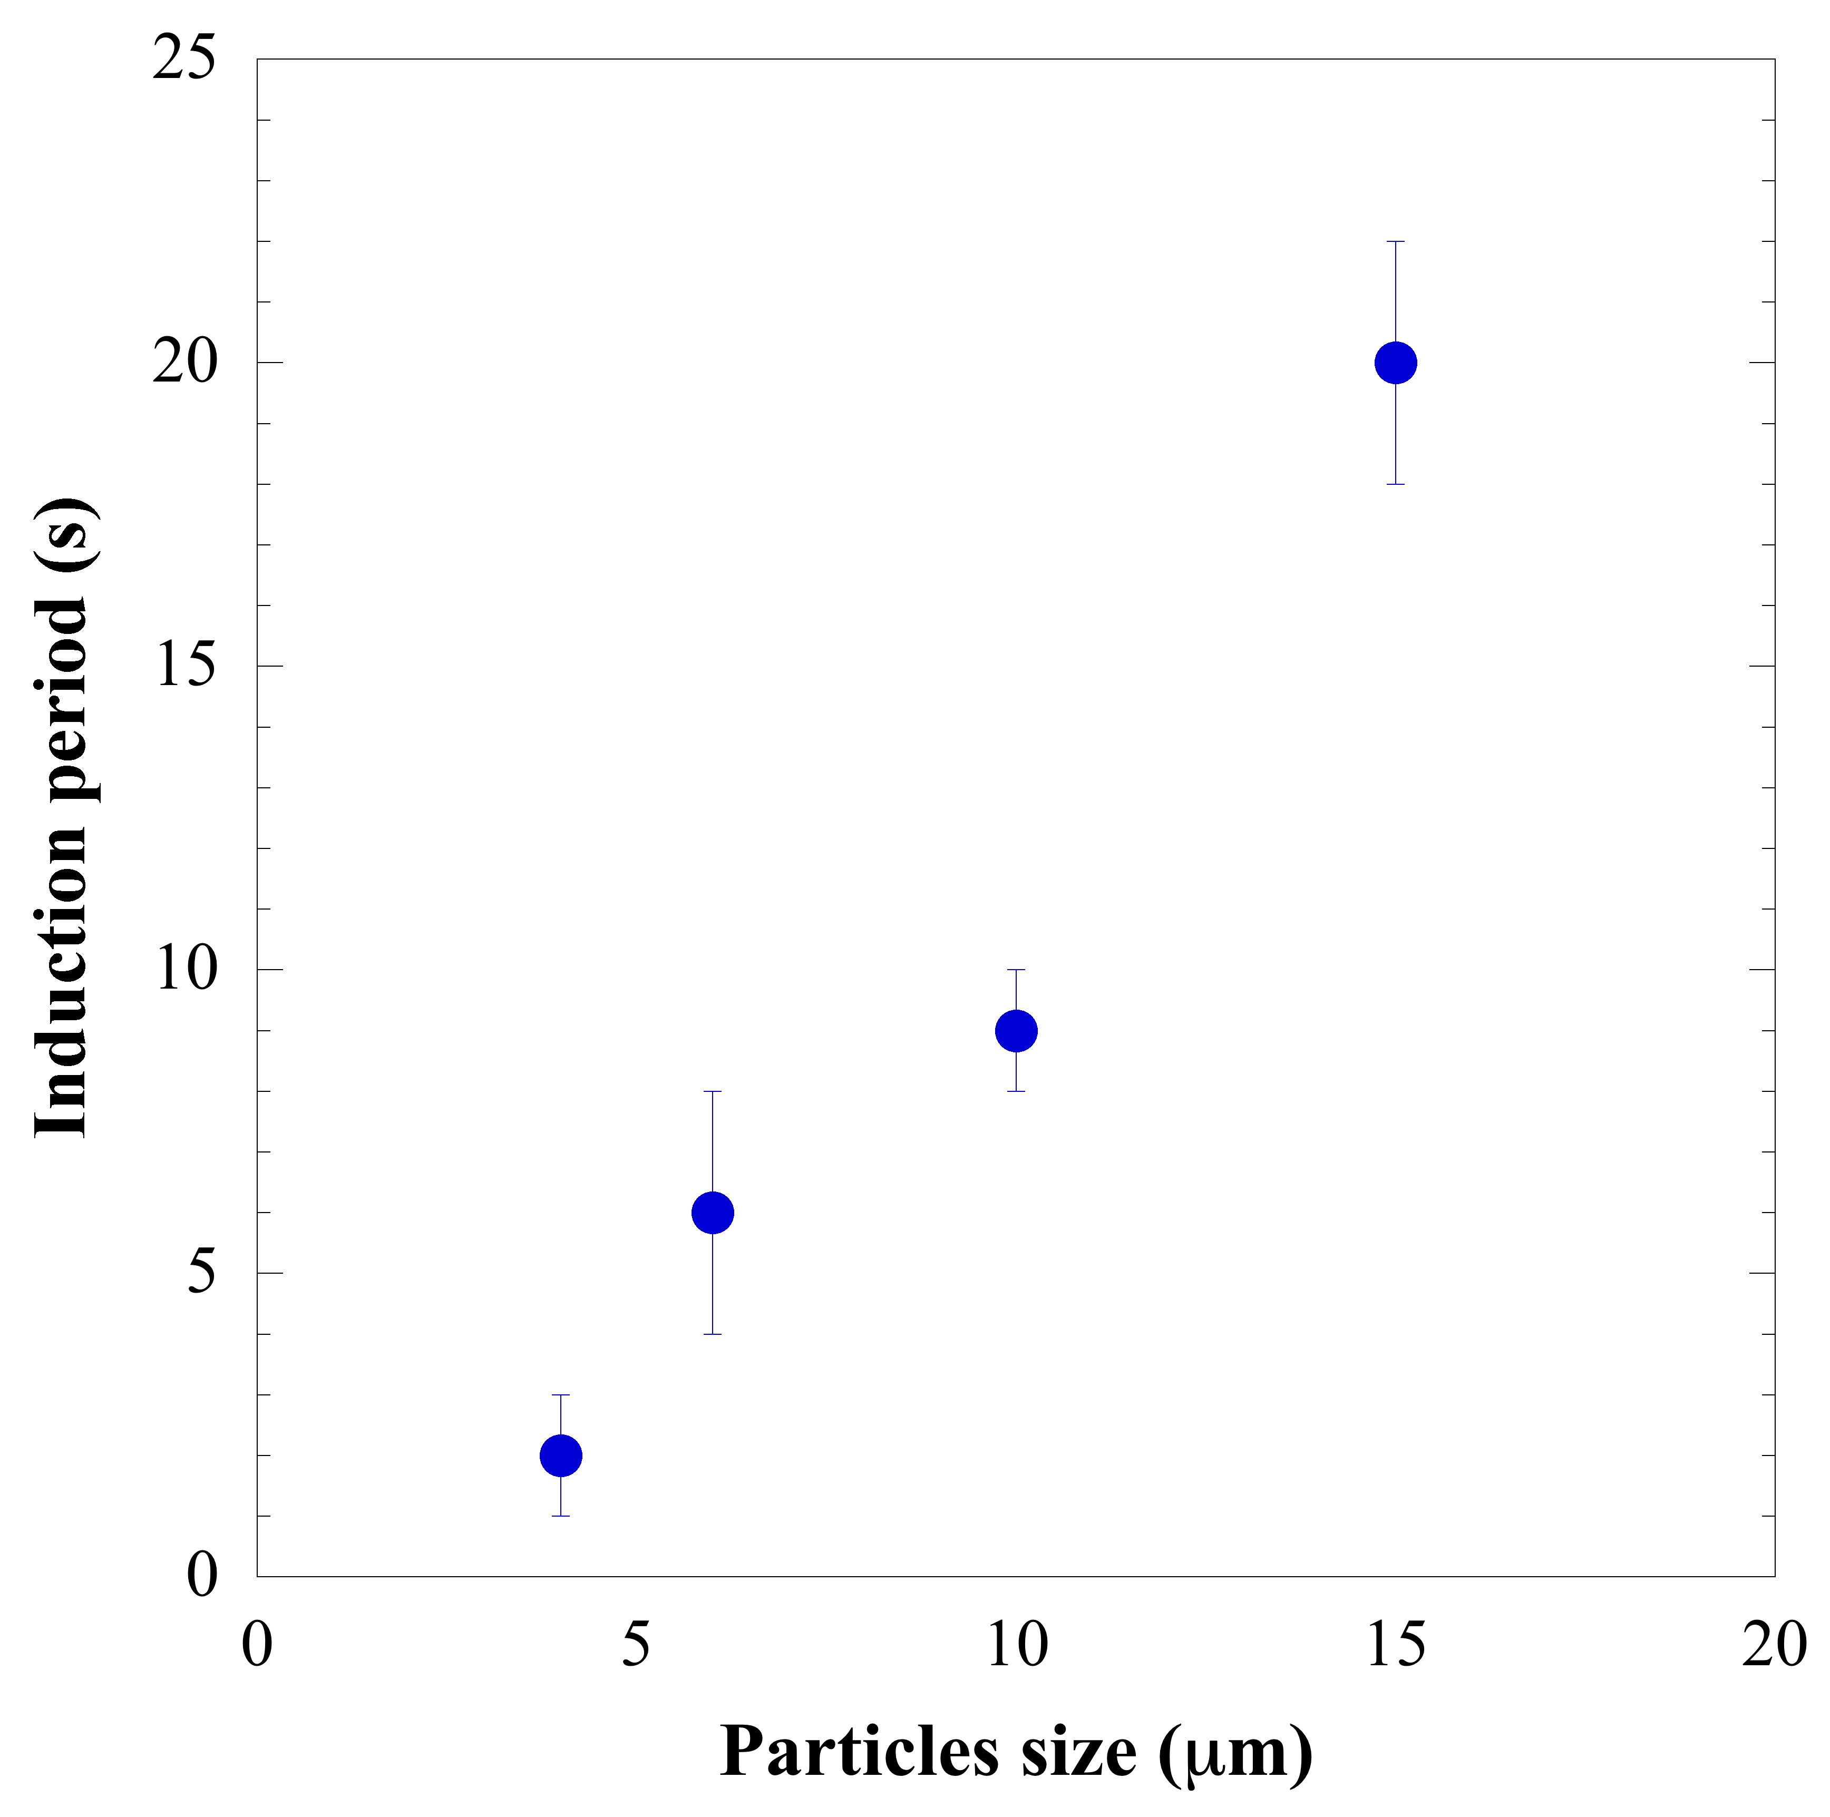
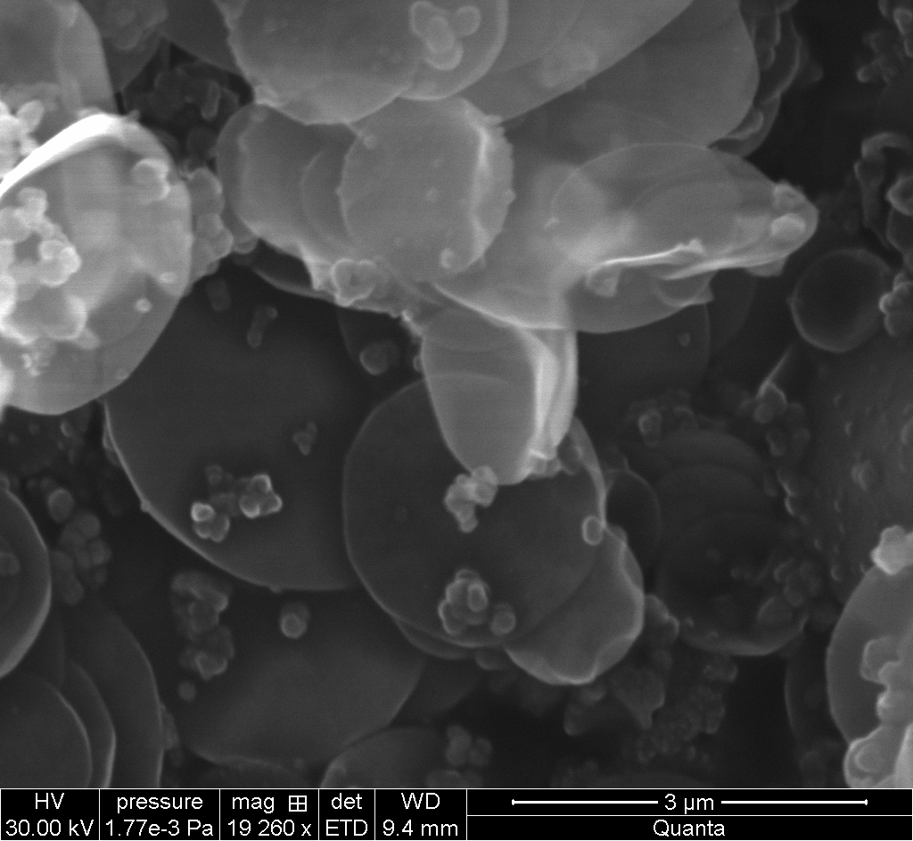
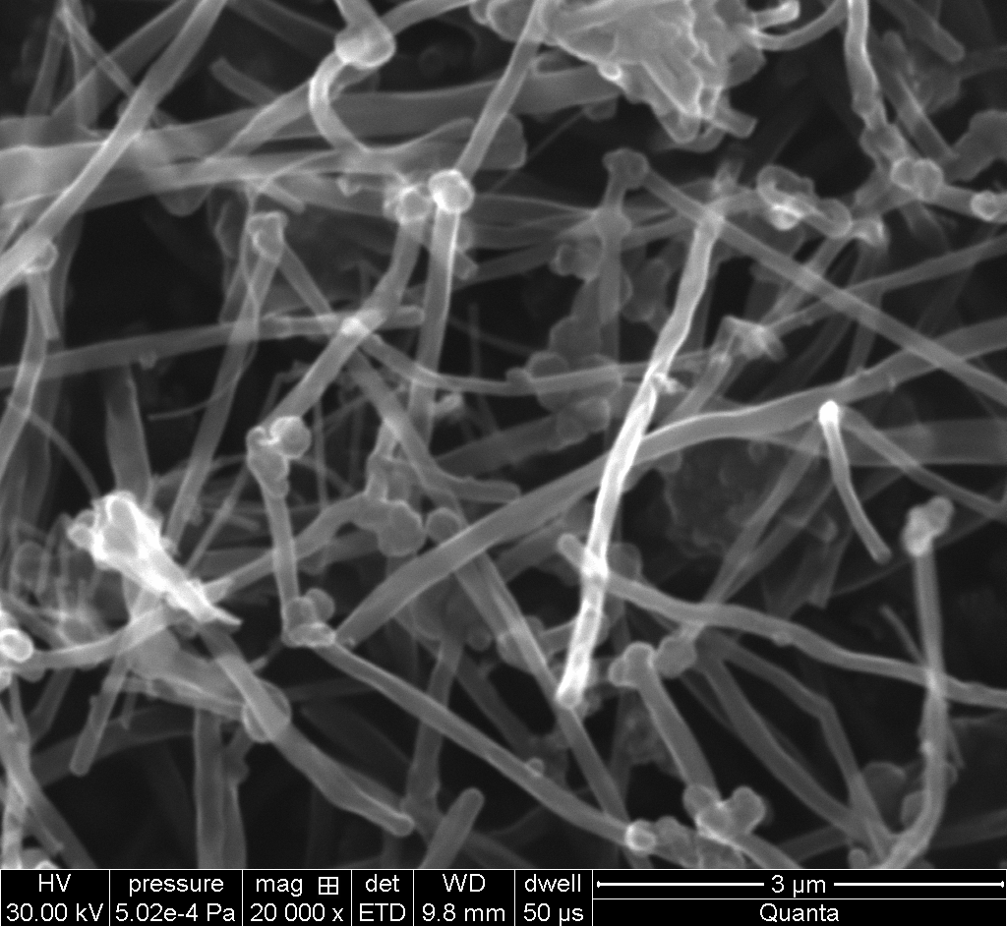
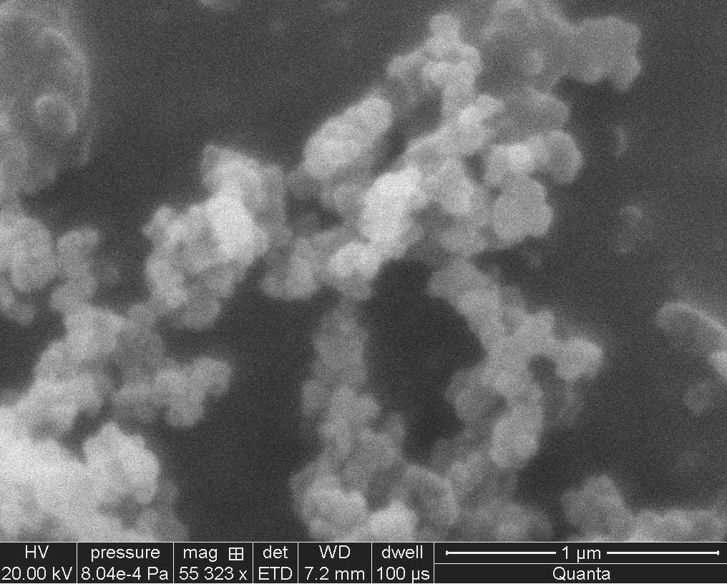
New lubrication strategies
New additives: micro/nanoparticles of tribo-active phases (graphite,
MoS₂) or precursors of tribo-active phases (C and inorganic
nanotubes or fullerenes) dispersed in the lubricant base
Immediate formation of the tribofilm in the sliding contact
conditions without any chemical reactions with the substrates
Synthetic graphite
The induction period strongly depends on the size
of the particles: feeding of the sliding interface
Study of fluorinated nanocarbons
2D structure
Tubular 1D structure
Spherical 0D structure
Carbon Nanodiscs
(CNDs)
Carbon Nanofibers
(CNFs)
Graphitized Carbon Blacks
(GCBs)

Slide 11
Tribologic experimental device
Motor
Normal load F_{n}
Sphere
AISI 52100
steel ball
Plane
x,y,z sample
holder
F_{t}
Fluorinated carbon film
AISI 52100
steel plane
Measurement of
the lateral force F_{t}
Normal load: 10 N
Contact area diameter: 140 μm
Maximum contact Pressure: 1 GPa
- Sliding speed: 6 mm/s
Friction coefficient μ = F_{t} / F_{n}
Plane
The ball goes forward
The ball stops ans reverses
Friction coefficient
Friction coefficient
μ = (α-β)/2
The ball moves back
Cycles number
Cycles number
Cycle = reciprocal travel of the ball on the static plane

Slide 12
Nanocarbons fluorination
Fluorination under F₂ atmosphere at selected temperatures in order
to obtain controlled fluorine contents (expressed as atomic F/C ratio)
F/C ≈ 1
F/C ≈ 1
F/C ≈ 1
Graphitized Carbon Blacks (GCBs)
Carbon Nanofibers (CNFs)
Carbon Nanodiscs (CNDs)
Starting material | T_{F} range (°C) | F/C range*
CNDs | 450-520 | 0.14-1.0
CNFs | 380-480 | 0.06–1.04
GCBs | 320-340 | 0.08-1.04
*F/C ratios were determined by weight uptake or ¹³C and ¹⁹F NMR
Covalent C-F bonds

Slide 13
Tribologic properties of fluorinated nanocarbons
● Fluorination improves the friction
properties
μ_{fluorinated materials} < μ_{pristine compounds}
● Carbon nanodiscs (CNDs): the
friction properties do not depend on
the fluorine content
μ ≈ 0.08 for all the tested
compounds
● Carbon nanofibers (CNFs) and
graphitized carbon blacks (GCBs):
the friction properties depend on
the fluorine content
Linear decrease of μ for
0 < F/C < 0.15 for CNFs and
0 < F/C < 0.6 for CBGs
Stabilization at μ ≈ 0.08 for
higher F/C ratios

Slide 14
Tribologic properties of fluorinated nanocarbons
● Very low values of μ
Fluorinated nanocarbons
present excellent friction
reduction properties
Different tribologic behaviour
depending on the morphology of
the particles
Different friction reduction
mechanisms

Slide 15
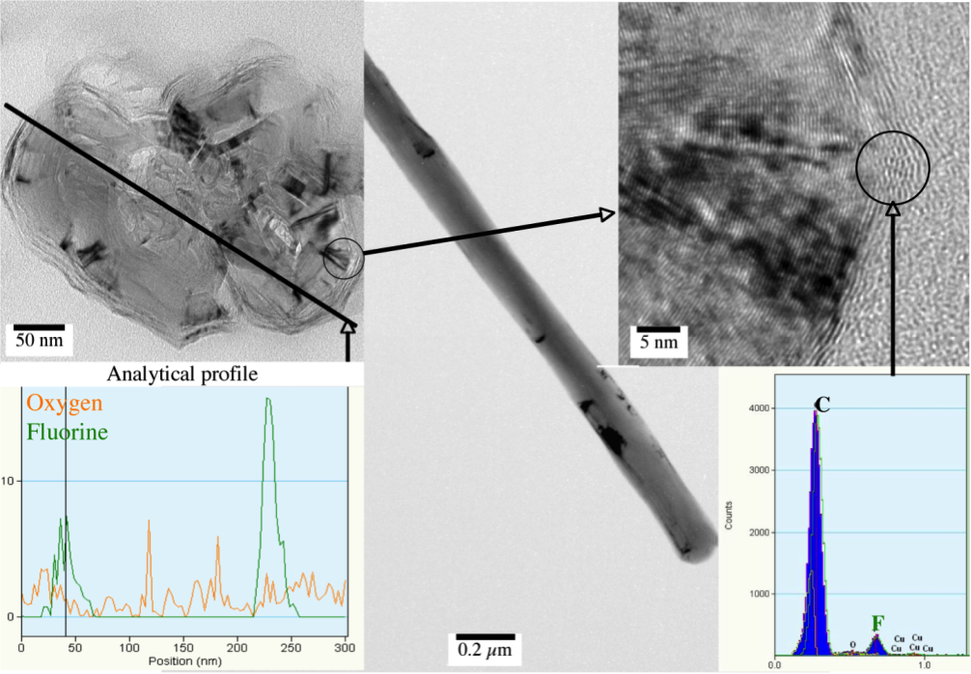
Friction reduction mechanisms
Friction reduction mechanisms of CNFs: correlation between friction
properties and structural characterizations
TEM investigation of a cross section of a fluorinated CNF
F/C = 0.15
● Lattice fringes corresponding
to graphitic structure are
visible in the internal part of
the fiber
● Presence of fluorine at the
periphery
Progressive fluorination proceeding from the outer part of the carbon nanofiber towards its core as far as the fluorination temperature increases

Slide 16
Friction reduction mechanisms
Friction reduction mechanisms of CNFs: correlation between friction
properties and structural characterizations
● μ for F/C < 0.15
Fluorination → Decrease of surface
free energy: minimum obtained for
F/C ≈ 0.15
● μ ≈ 0.08 for F/C > 0.15
Fluorination progresses towards the
fibres core : no significant evolution
of the surface free energy
CNFs
Friction reduction mechanism involving
surface effects (individual nanofibers
interactions)

Slide 17
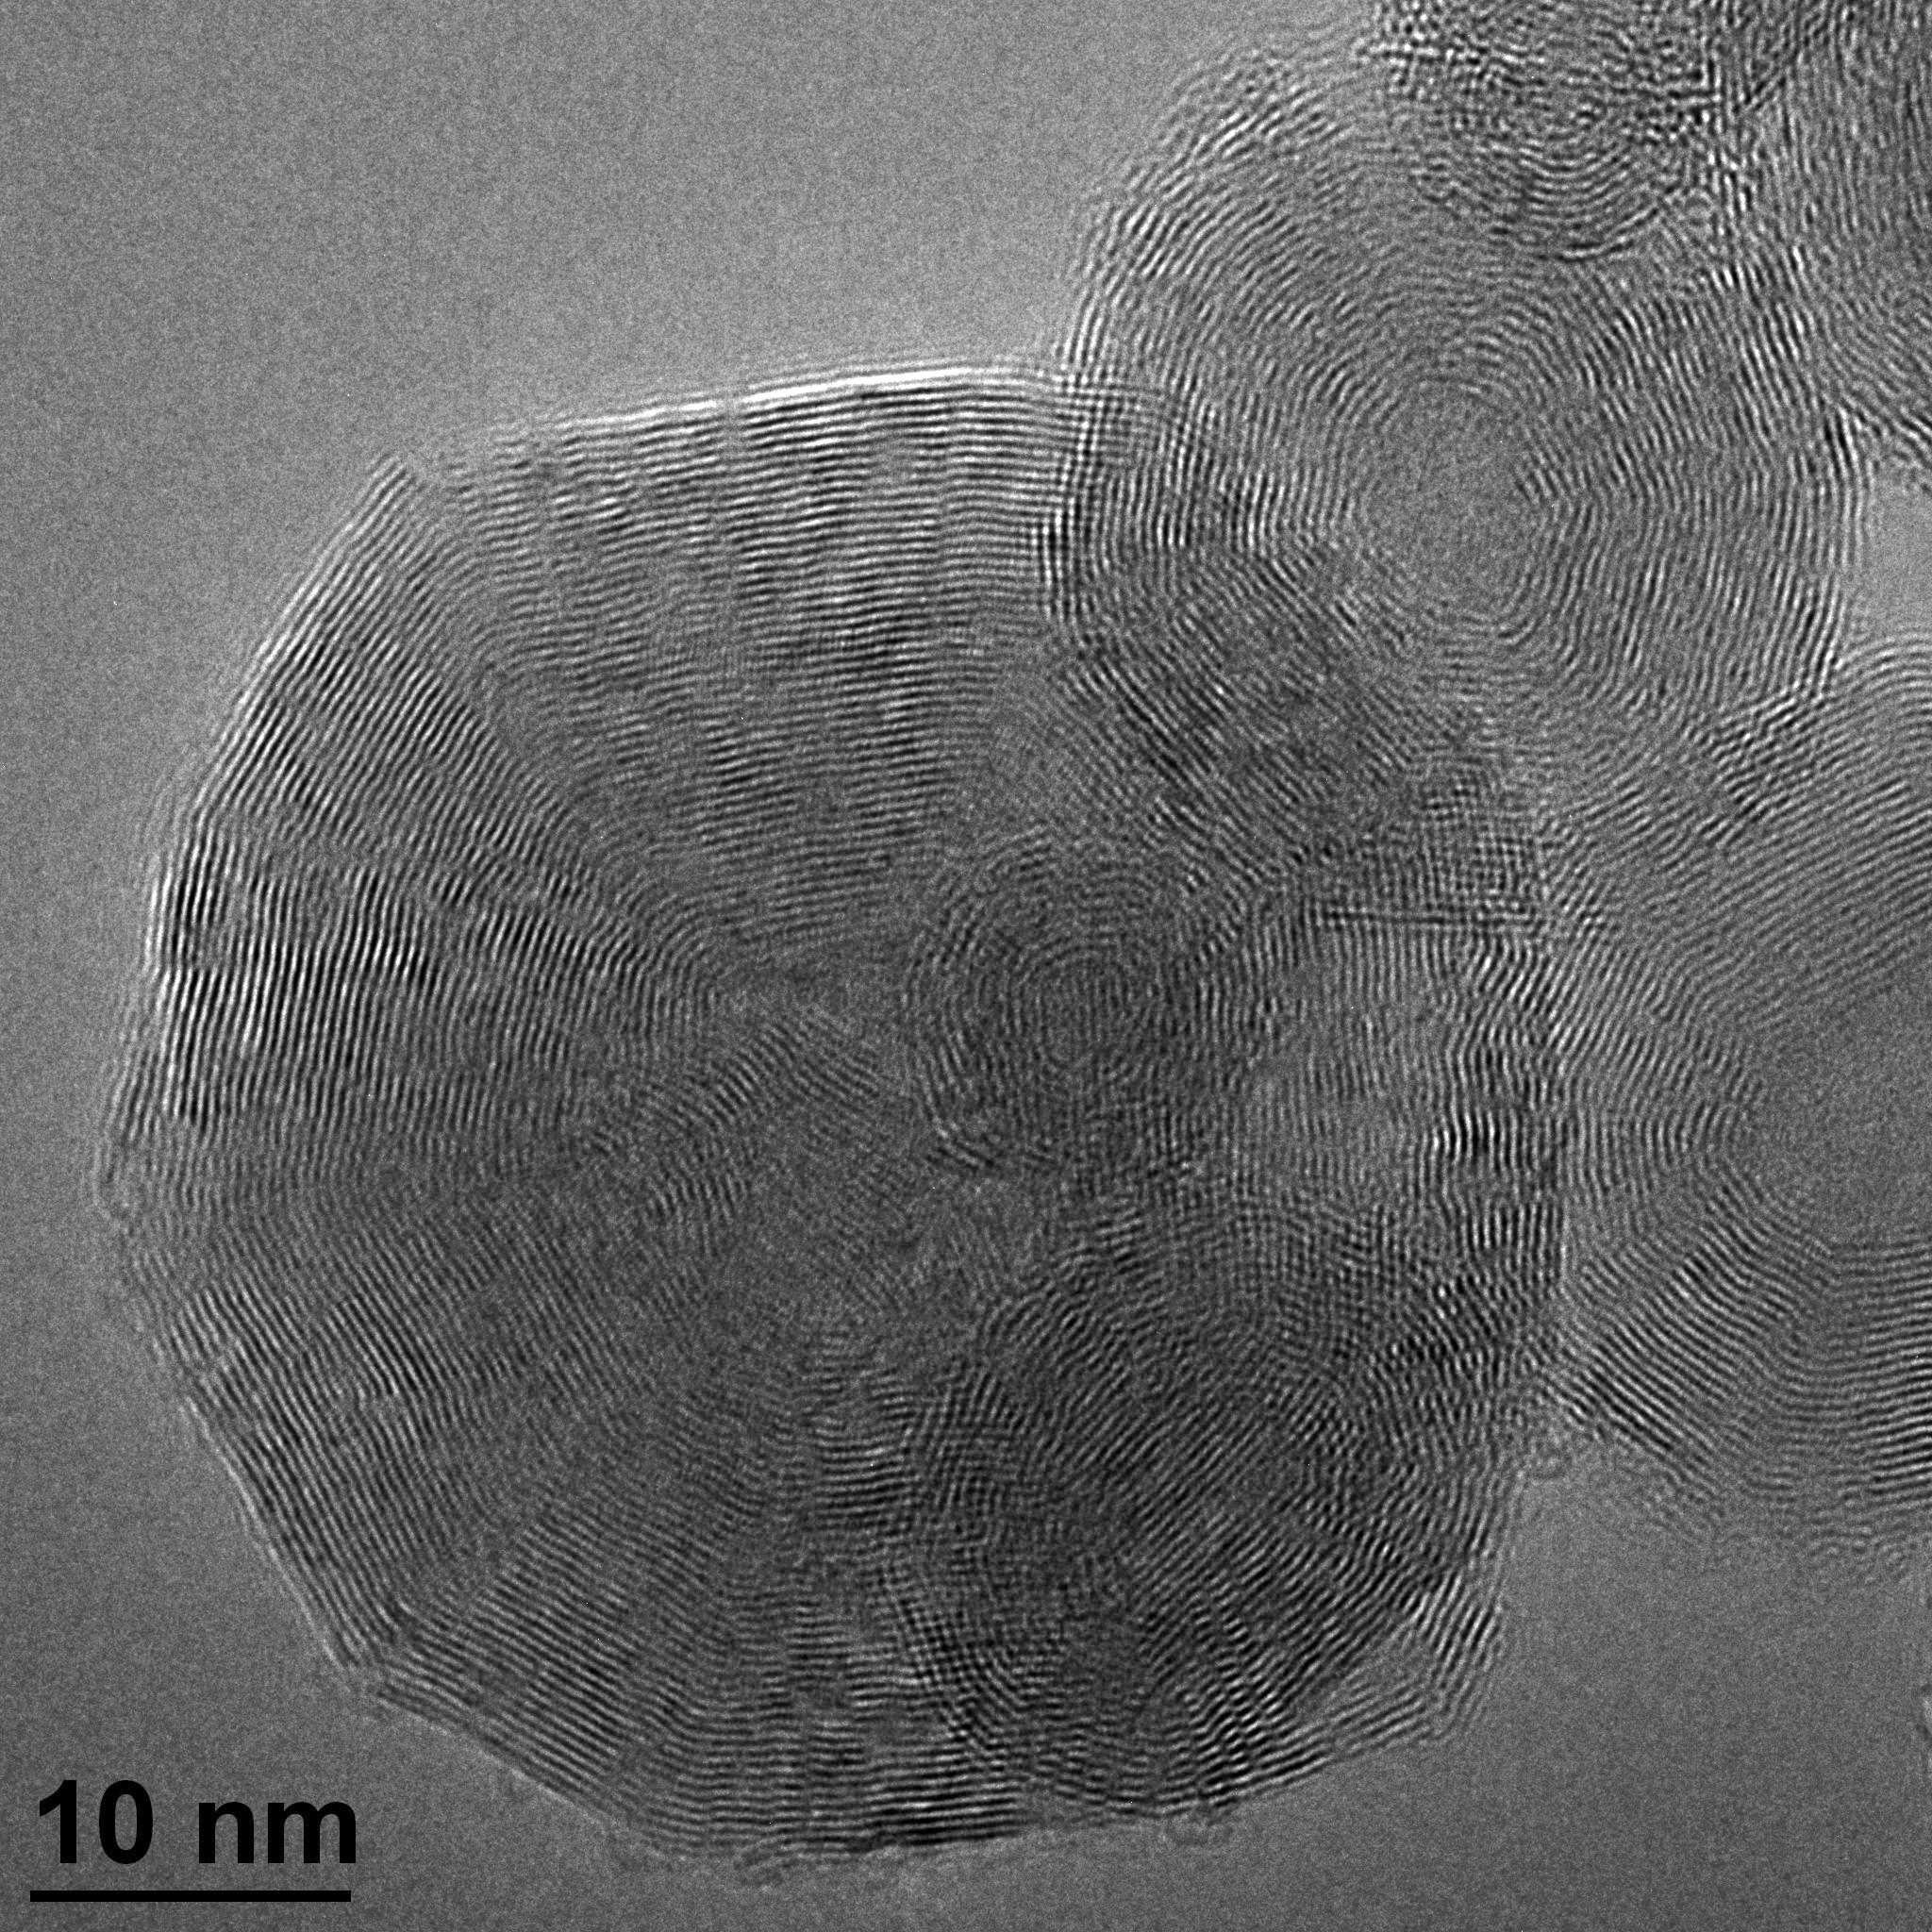
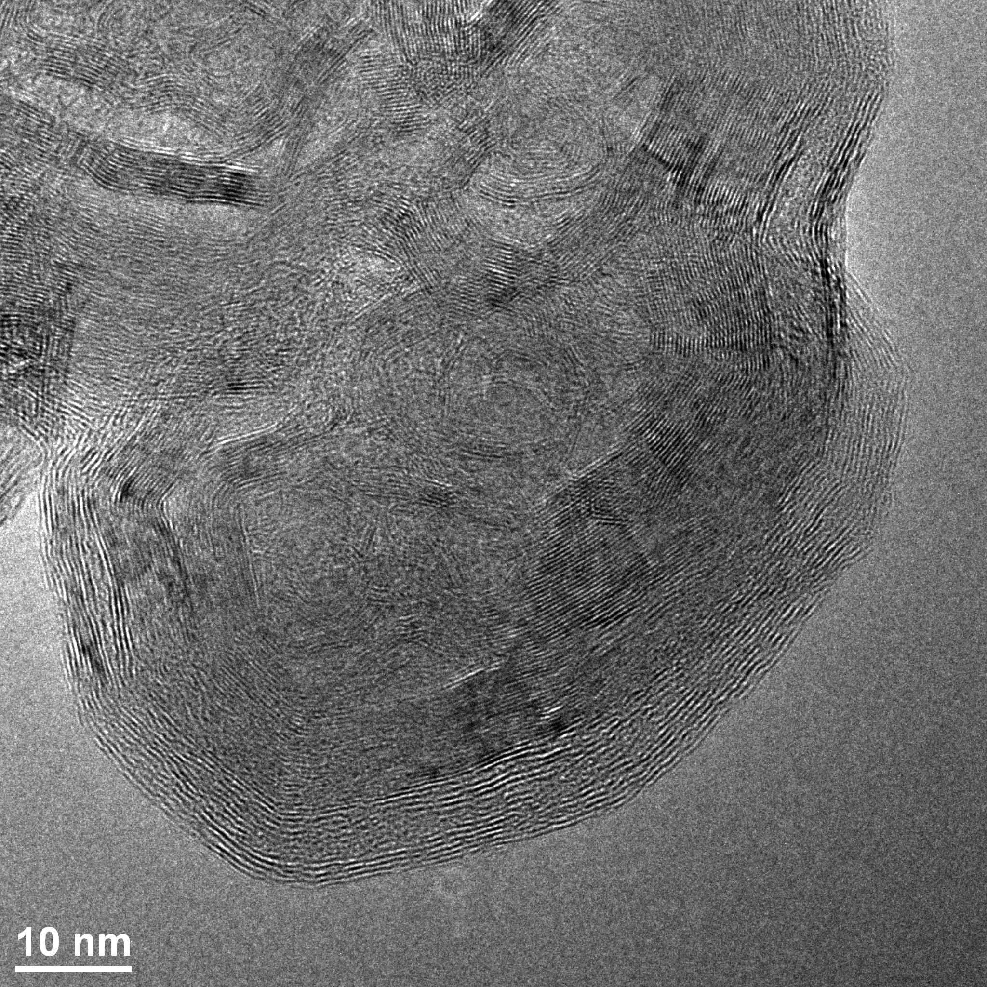
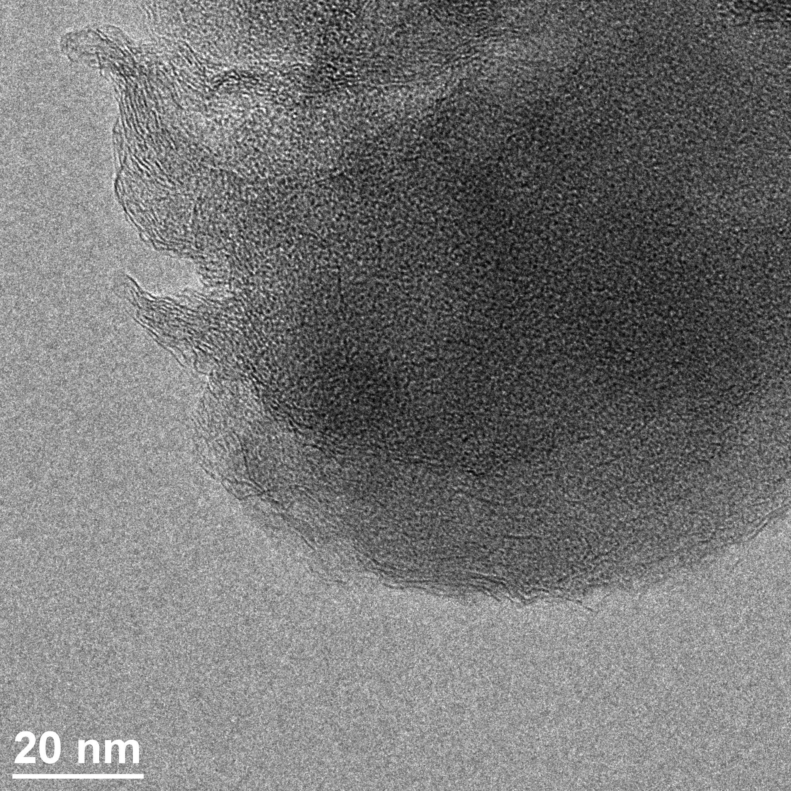
Friction reduction mechanisms
Friction reduction mechanisms of GCBs: correlation between friction
properties and structural characterizations
TEM characterization of fluorinated GCBs
Pristine CBGs
CF0.16
CF0.89
Graphene layers
d = 0.34 nm
d = 0.34 nm
Fluorinated layers
d = 0.48 nm
● Pristine materials present a graphitic structure
● The fluorinated parts are characterized by an increase of the interplanar distance (d = 0.48 nm) compared to graphite one (d = 0.34 nm)

Slide 18
Friction reduction mechanisms
Friction reduction mechanisms of GCBs: correlation between friction
properties and structural characterizations
TEM characterization of fluorinated GCBs
Pristine CBGs
CF0.16
CF0.89
Graphene layers
d = 0.34 nm
d = 0.34 nm
Fluorinated layers
d = 0.48 nm
The fluorination process progresses from external layers towards inner ones

Slide 19
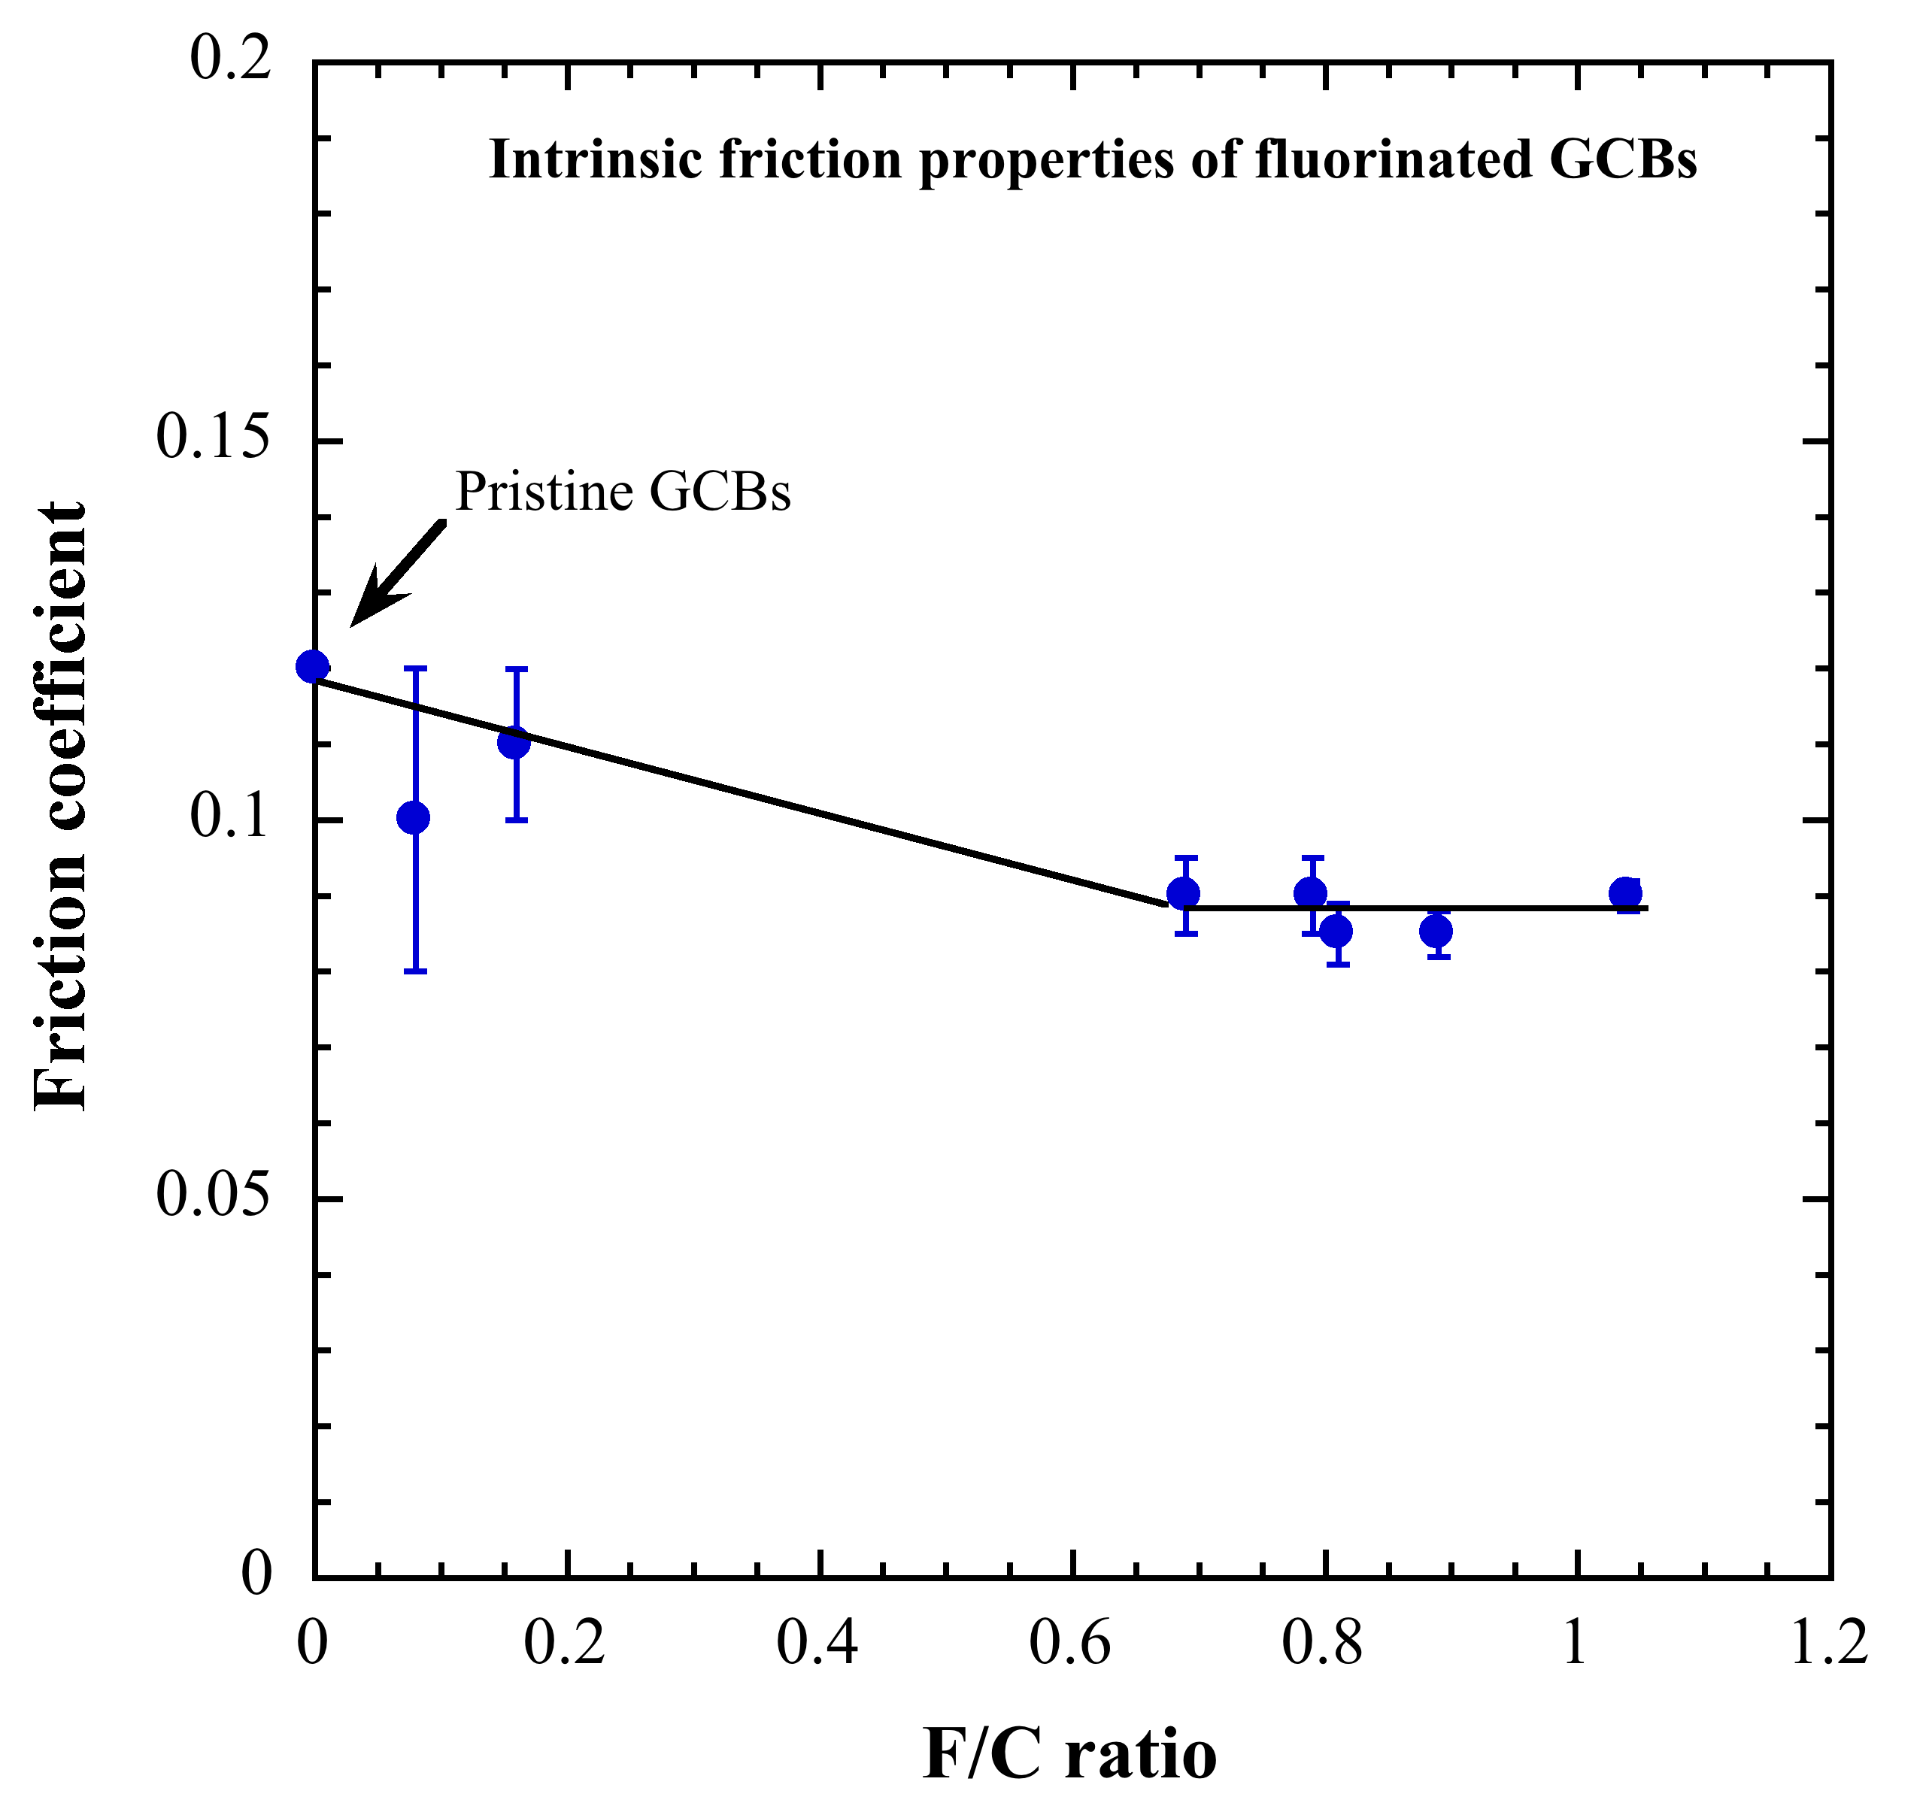
Friction reduction mechanisms
Friction reduction mechanisms of GCBs: correlation between friction
properties and structural characterizations
● Decrease of μ associated to the
lowering of surface energy of the
particles due to the thickening of
the fluorinated layer
● The thickness of the surrounding
fluorinated layer is sufficient to
stabilize the surface energy of the
particles
No more surface effects: stabilization
of the friction coefficient
Friction reduction mechanism involving surface effects

Slide 20
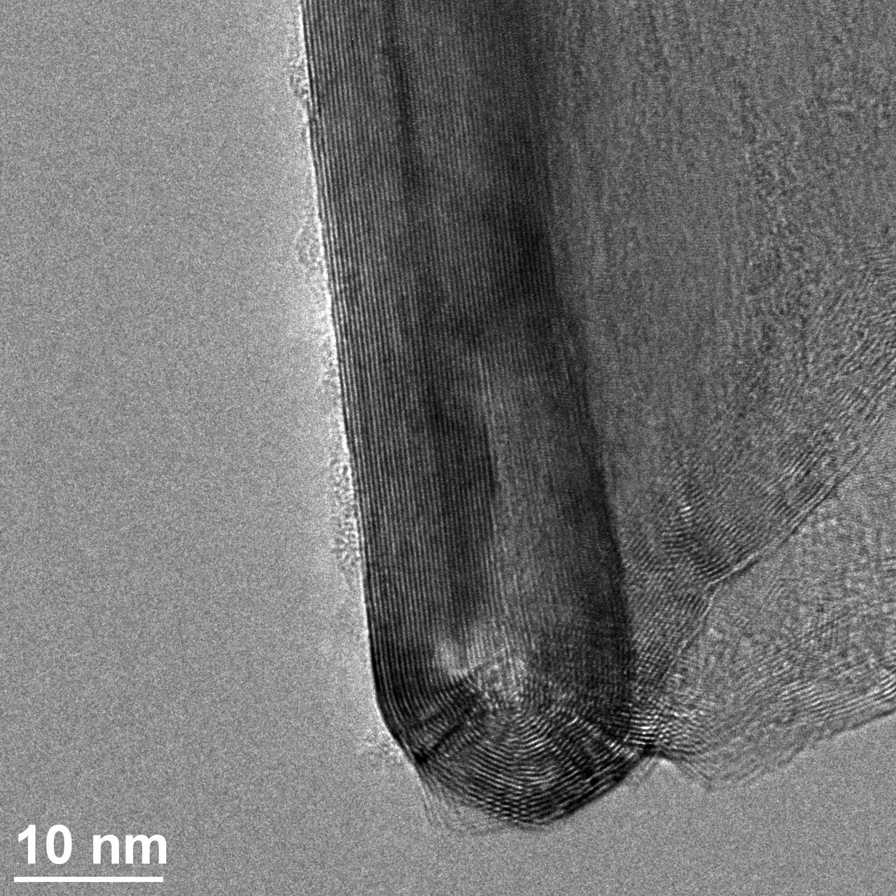
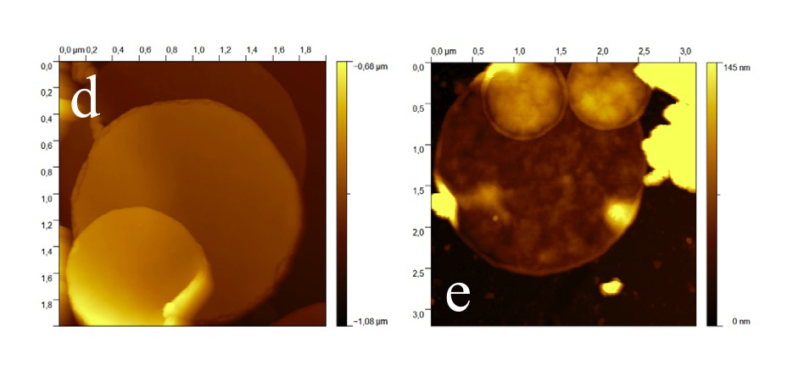
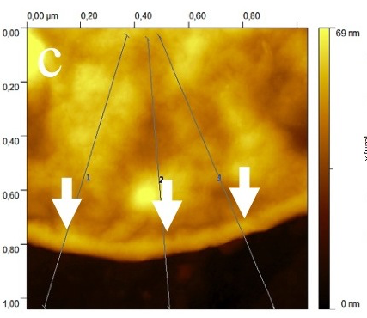
Friction reduction mechanisms
Friction reduction mechanisms of CNDs: correlation between friction
properties and structural characterizations
TEM Characterization
AFM investigations
F/C = 0.78
● Swelling is more pronounced at the edges of the nanodiscs
● Swelling of the edges is visible in the overall perimeter
The fluorination process mainly occurs via the edges of the CNDs

Slide 21
Friction reduction mechanisms
Friction reduction mechanisms of CNDs: correlation between friction
properties and structural characterizations
F/C = 0.78
F₂
CND
F₂
● Fluorination occurs via the edges: the fluorine atoms diffuse in the whole volume
The friction coefficient does not depend on the fluorine content: friction
reduction mecanisms implying bulk effects

Slide 22
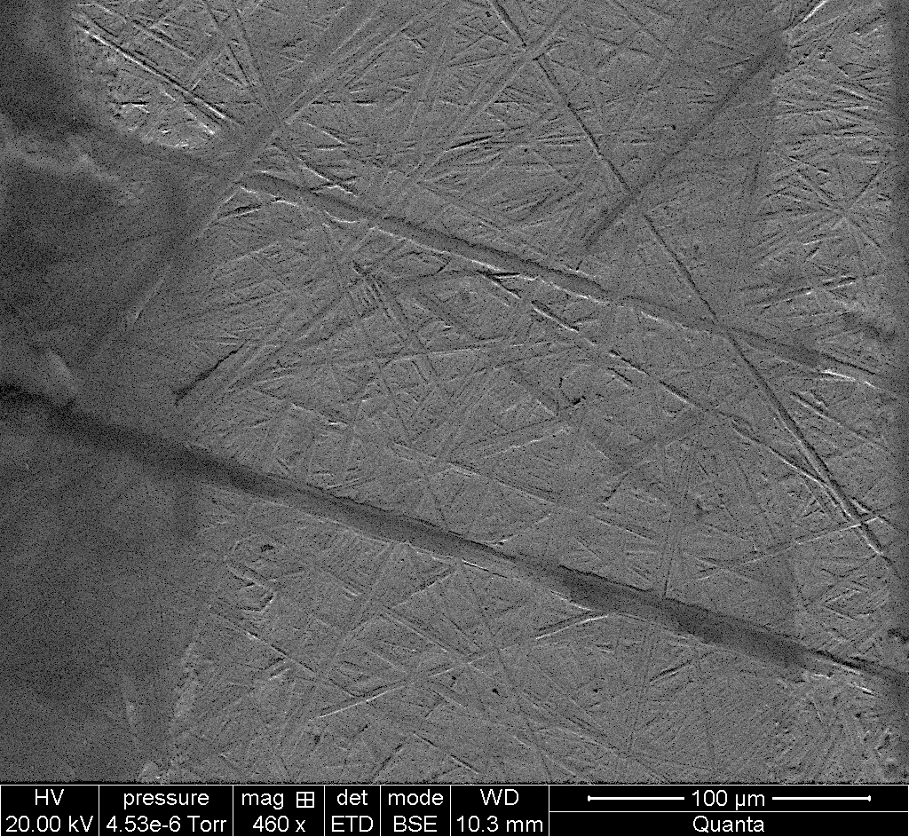
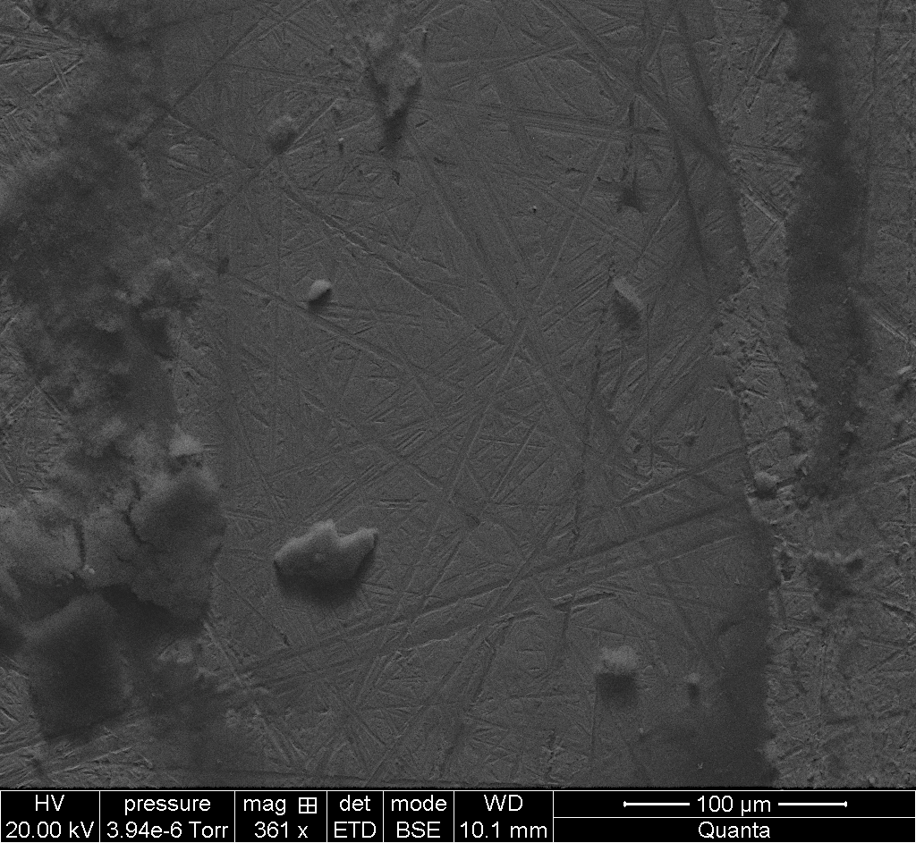
Antiwear properties of fluorinated nanocarbons
GCBs
CF0.16 1000 cycles
GCBs
CF0.89 1000 cycles
Initial scratches
Initial scratches
● Initial scratches are still visible after 1000 cycles of friction: very weak wear
● Same observations for all the tested compounds
Fluorinated nanocarbons present good antiwear properties

Slide 23
Conclusions
● Fluorination improves the friction performances of nanocarbons
● Friction reduction mechanisms depend on the morphology of the particles
Bulk effects
Carbon nanodiscs (2D)
Surface effects
Carbon nanofibers (1D)
graphitized carbon blacks (0D)
● Promising new nano-additives for liquid or gel lubricants
- Very low friction coefficient: μ ≈ 0.08
- Very good durability of the friction performances
- Instantaneous protective action: no induction period
- Good antiwear properties
- Sizes and geometries well adapted for a good feeding of the sliding interface

Slide 24
Thank you for your attention
ACKNOWLEDGEMENTS: The authors acknowledge the CNRS, the Conseil Régional de la Guadeloupe, the Fond Social Européen (FSE) and Fonds Européens de Développement Régional (FEDER) for their financial supports.

Slide 26
Friction reduction mechanisms
Study of the tribofilms: SEM investigations
Carbon nanodiscs
Ball
Tribofilm
Aspect of the tribofilm
Particles extracted from
the wear scar
High contact pressure zone:
very smooth aspect
Plane
High pressure zone
1 μm
Low pressure
zone
2 μm
Individual nanodiscs
The tribofilm is mainly amorphous
with some individual discs
embedded in the disordered phase
Low contact pressure zone: the discs
are oriented parallel to the sliding
direction

Slide 27
Friction reduction mechanisms
Study of the tribofilms: SEM investigations
Carbon nanofibers
Low pressure
zone
Ball
Tribofilm
Aspect of the tribofilm
Particles extracted from
the wear scar
Plane
High pressure zone: continuous
aspect with ondulations
High pressure zone
Pristine CNFs
b)
Pristine CNFs
Pristine CNFs
F/C = 0.39
Tangled fibers
Tribofilms constituted of individual
nanofibers covered by an ill organized
layer (0.3 μm thickness)
Low contact pressure zone: orientation
of the fibers along the sliding direction

Slide 28

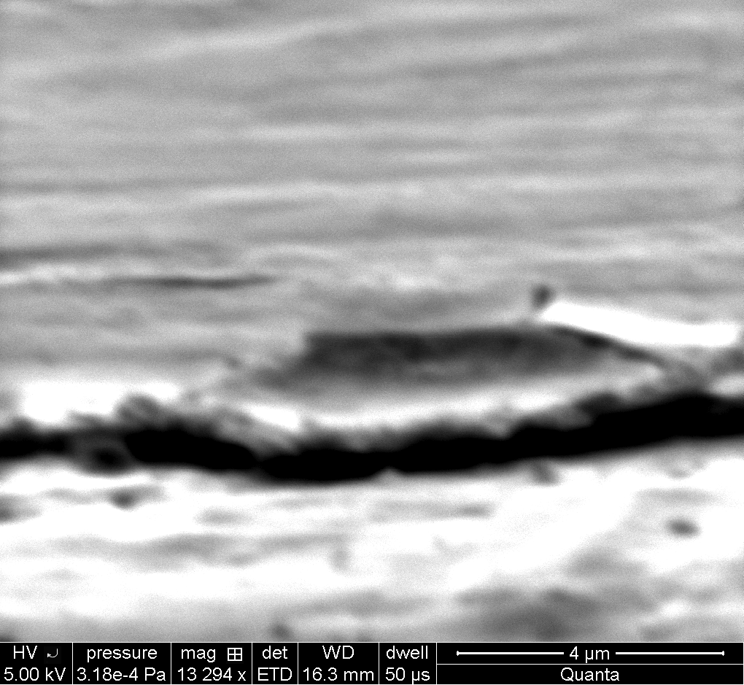
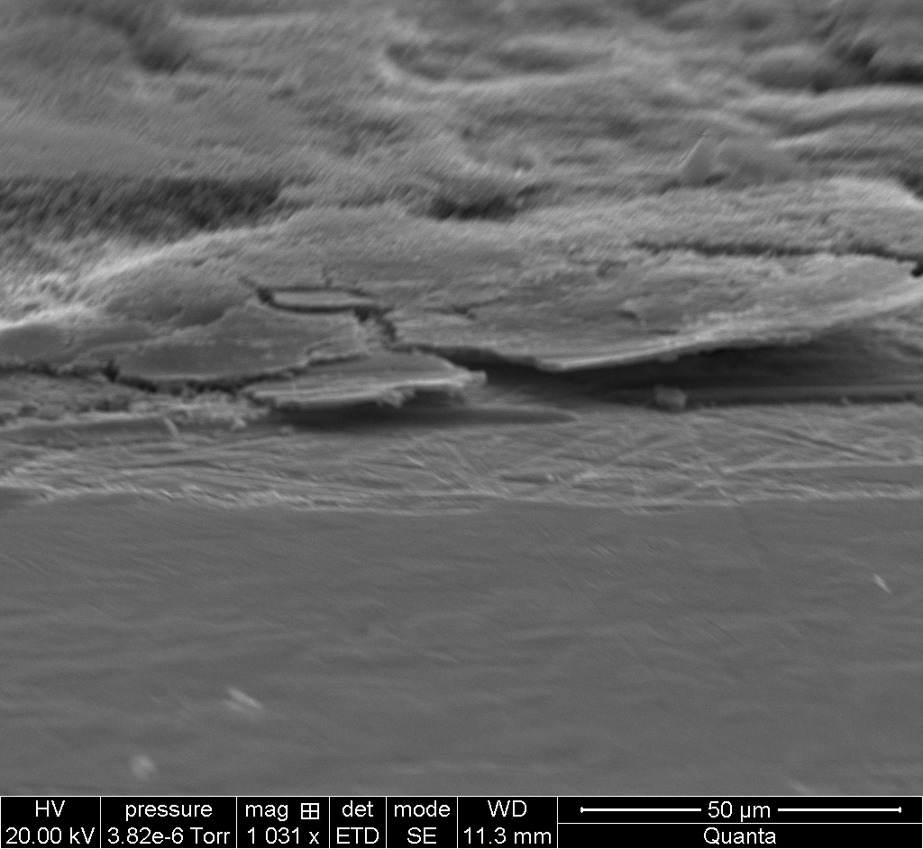

Friction reduction mechanisms
Study of the tribofilms: SEM investigations
Graphitized carbon blacks
Low pressure
zone
Ball
Tribofilm
Aspect of the tribofilm
Wear scar
Plane
High pressure zone
0.2 μm
Low
pressure zone
high
pressure zone
2 μm
Tribofilms seems to be
constituted of individual
CBGs embedded in a
disordered phase

